Slide 1
API Design

Slide 2
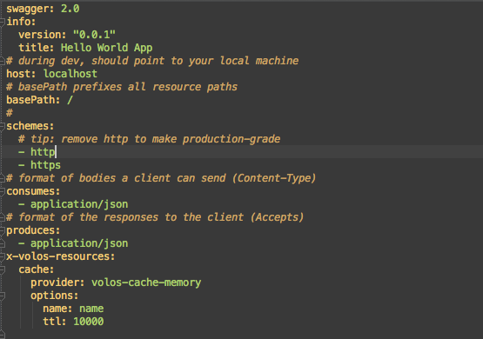
Swagger

Slide 3
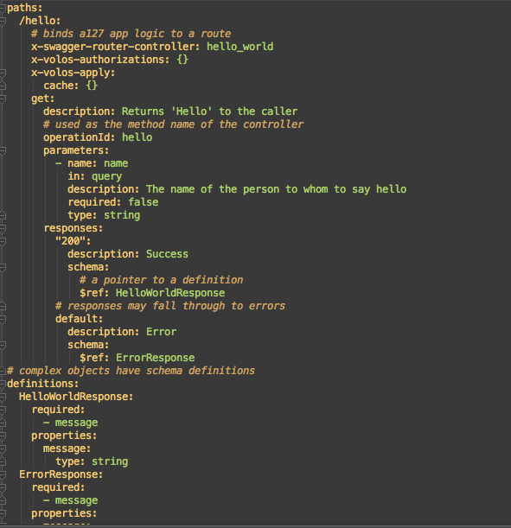
Swagger

Slide 4
Swagger
swagger: 2 - (Required) Identifies the version of the Swagger specification (2.0).
info: - (Required) Provides metadata about the API.
host: - (Optional) The host serving the API. By default, a new project connects to a server running locally on port 10010.
basePath: - (Optional) The base path on which the API is served, which is relative to the host.
schemes: - (Optional) A list of transfer protocol(s) of the API.
consumes: - (Optional) A list of MIME types the APIs can consume.
produces: - (Optional) A list of MIME types the APIs can produce

Slide 5
Swagger
x-a127-services: - (Optional) A custom Swagger extension for the volos-swaggermodule. The volos-swagger module lets you add Volos.js features like quotas, caching, and OAuth 2.0 to your API by configuring them in the Swagger file. For more information, see the volos-swagger README file.
paths: - (Required) Defines the available operations on the API. You'll spend most of your time configuring the paths part of the file. You can read about the path element in the Swagger 2.0 specification. In general, the paths section specifies an operation's verb (like get), the endpoint for an API operation (like /hello), query parameters, and responses.

Slide 6
Swagger
definitions: - (Optional) These represent the structure of complex objects such as request and response bodies. For example, you might have a collection of /users that returns an array of user objects. You would describe these with two definitions: 1) to describe the User object, and 2) the definition of the Users array. Swagger uses JSON-schema.

Slide 7
Security Definitions
securityDefinitions: (Optional) Represent the structure of Swagger 2.0 security schemes, such as OAuth 2.0. Swagger uses JSON-schema. For an example, see Add Apigee Edge OAuth 2.0 Security to an API

Slide 8
Extensions
x-swagger-router-controller: - (Optional) This extension specifies the name of the controller file (hello_world.js) that will execute when this API operation is called. Controller files reside in apis/controllers in your Apigee-127 project. This extension is provided through the swagger-tools middleware module, which is included when you require the a127-magic module in your main Node.js app.
x-a127-apply: - (Optional) This extension applies specified volos modules, and they use the configurations specified in the x-a127-services extension, described previously. For more information, see the volos-swagger README file.

Slide 9

Extensions
x-a127-config: Use this extension to configure authentication values required to run your API in conjunction with Apigee Edge. Lets you configure the apigeeProxyKeyand apigeeProxyUri. The apigeProxyKey is used for authentication on Edge, and theapigeeProxyUri is the Uri location of the apigee-remote-proxy endpoint. These values are set when you create an Apigee account for your Apigee-127 project (a127 project create myaccount)

Slide 10
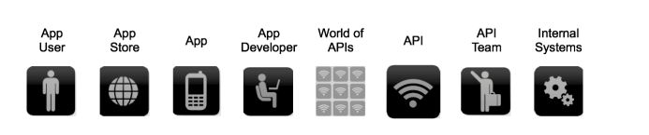
API Value chain
Design for developer productivity

Slide 11
Nouns and Url
Nouns are good; verbs are bad
The number one principle in pragmatic RESTful design is: keep simple things simple
Keep your base URL simple and intuitive The base URL is the most important design affordance of your API. A simple and intuitive base URL design makes using your API easy

Slide 12
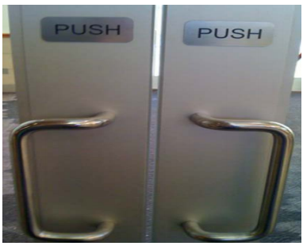
Bad Design

Slide 13
Dogs
Let's model an API around a simple object or resource, a dog, and create a Web API for it.
The first URL is for a collection; the second is for a specific element in the collection. /dogs /dogs/1234

Slide 14
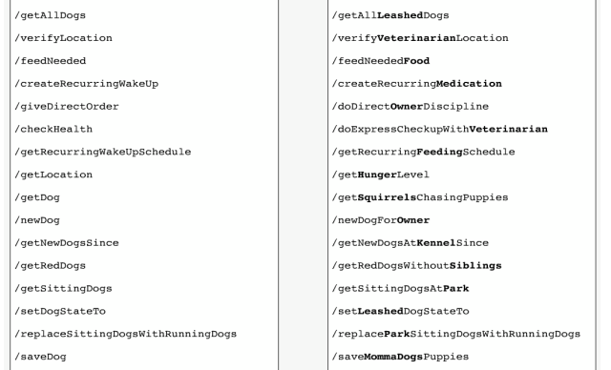
Getting Crazy

Slide 15
HTTP Verbs
Use HTTP verbs to operate on the collections and elements. For our dog resources, we have two base URLs that use nouns as labels, and we can operate on them with HTTP verbs. Our HTTP verbs are POST, GET, PUT, and DELETE. (We think of them as mapping to the acronym, CRUD (Create-Read-Update-Delete).)

Slide 16
Url and HTTP Verb
Resource | POST Create | GET Read | PUT Update | DELETE Delete
/dogs | Create a new dog | List Dogs | Bulk update dogs | Delete all dogs
/dogs/1234 | Error | Show dog with id 1234 | Update dog with id 1234 | Delete dog with id 1234
Use two base URLs per resource.
Keep verbs out of your base URLs.
Use HTTP verbs to operate on the collections and elements

Slide 17
Be Consistent
Let’s explore how to pick the nouns for your URLs. Should you choose singular or plural nouns for your resource names?
You'll see popular APIs use both. Let's look at a few examples:
Foursquare /checkins
GroupOn /deals
Zappos /Product
Given that the first thing most people probably do with a RESTful API is a GET, we think it reads more easily and is more intuitive to use plural nouns. But above all, avoid a mixed model in which you use singular for some resources, plural for others.

Slide 18
Associations
Remember, we had two base URLs: /dogs and dogs/1234
Our dogs belong to owners. To get all the dogs belonging to a specific owner, or to create a new dog for that owner, do a GET or a POST:
GET /owners/5678/dogs
POST /owners/5678/dogs
In other words, you shouldn't need too many cases where a URL is deeper than what we have above /resource/identifier/resource.

Slide 19
Sweep complexity into Query
Make it simple for developers to use the base URL by putting optional states and attributes behind the HTTP question mark. To get all red dogs running in the park: GET /dogs?color=red&state=running&location=park

Slide 20
Errors
How to think about errors in a pragmatic way with REST? Let's take a look at how three top APIs approach it.
Facebook HTTP Status Code: 200
{"type" : "OauthException", "message":"(#803) Some of the aliases you requested do not exist: foo.bar"}
Twilio HTTP Status Code: 401
{"status" : "401", "message":"Authenticate","code": 20003, "more info": "http://www.twilio.com/docs/errors/20003"}
SimpleGeo HTTP Status Code: 401
{"code" : 401, "message": "Authentication Required"}
Notes:
Facebook No matter what happens on a Facebook request, you get back the 200-status code - everything is OK. Many error messages also push down into the HTTP response. Here they also throw an #803 error but with no information about what #803 is or how to react to it.
Twilio Twilio does a great job aligning errors with HTTP status codes. Like Facebook, they provide a more granular error message but with a link that takes you to the documentation. Community commenting and discussion on the documentation helps to build a body of information and adds context for developers experiencing these errors.
SimpleGeo SimpleGeo provides error codes but with no additional value in the payload.

Slide 21
Errors
Use HTTP status codes and try to map them cleanly to relevant standard-based codes.
Everything worked – success
200
The application did something wrong – client error
400: Bad Request
The API did something wrong – server error
500: Server Error

Slide 22
Errors – Consider These
201 – Created
202 – implies async
204 - Deleted
304 - Not Modified
404 – Not Found
401 - Unauthorized
403 – Forbidden
Message for people
{"developerMessage" : "Verbose, plain language description of the problem for the app developer with hints about how to fix it.", "userMessage":"Pass this message on to the app user if needed.", "errorCode" : 12345, "more info": "http://dev.teachdogrest.com/errors/12345"}

Slide 23
Versioning
Never release an API without a version and make the version mandatory.
Let's see how three top API providers handle versioning.
Twilio /2010-04-01/Accounts/
salesforce.com /services/data/v20.0/sobjects/Account
Facebook ?v=1.0
Notes:
Twilio uses a timestamp in the URL (note the European format). At compilation time, the developer includes the timestamp of the application when the code was compiled. That timestamp goes in all the HTTP requests. When a request arrives, Twilio does a look up. Based on the timestamp they identify the API that was valid when this code was created and route accordingly. It's a very clever and interesting approach, although we think it is a bit complex. For example, it can be confusing to understand whether the timestamp is the compilation time or the timestamp when the API was released.
Salesforce.com uses v20.0, placed somewhere in the middle of the URL. We like the use of the v. notation. However, we don't like using the .0 because it implies that the interface might be changing more frequently than it should. The logic behind an interface can change rapidly but the interface itself shouldn't change frequently.
Facebook also uses the v. notation but makes the version an optional parameter. This is problematic because as soon as Facebook forced the API up to the next version, all the apps that didn't include the version number broke and had to be pulled back and version number added.

Slide 24
Versioning
How to think about version numbers in a pragmatic way with REST?
Never release an API without a version.
Make the version mandatory.
Specify the version with a 'v' prefix. Move it all the way to the left in the URL so that it has the highest scope (e.g. /v1/dogs).
Use a simple ordinal number. Don't use the dot notation like v1.2 because it implies a granularity of versioning that doesn't work well with APIs--it's an interface not an implementation. Stick with v1, v2, and so on.

Slide 25
Versioning
How many versions should you maintain?
Maintain at least one version back.
For how long should you maintain a version?
Give developers at least one cycle to react before obsoleting a version. Sometimes that's 6 months; sometimes it’s 2 years. It depends on your developers' development platform, application type, and application users. For example, mobile apps take longer to rev’ than Web apps.

Slide 26
Partial Response
Let's look at how several leading APIs handle giving developers just what they need in responses, including Google who pioneered the idea of partial response.
LinkedIn
/people:(id,first-name,last-name,industry) This request on a person returns the ID, first name, last name, and the industry. LinkedIn does partial selection using this terse :(...) syntax which isn't self-evident. Plus it's difficult for a developer to reverse engineer the meaning using a search engine.
Facebook
/joe.smith/friends?fields=id,name,picture
Google
?fields=title,media:group(media:thumbnail)
Notes:
Partial response allows you to give developers just the information they need. Take for example a request for a tweet on the Twitter API. You'll get much more than a typical twitter app often needs - including the name of person, the text of the tweet, a timestamp, how often the message was re-tweeted, and a lot of metadata

Slide 27
Partial Response
Add optional fields in a comma-delimited list The Google approach works extremely well.
Here's how to get just the information we need from our dogs API using this approach:
/dogs?fields=name,color,location
It's simple to read; a developer can select just the information an app needs at a given time; it cuts down on bandwidth issues, which is important for mobile apps.

Slide 28
Pagination
Make it easy for developers to paginate objects in a database It's almost always a bad idea to return every resource in a database.
Let's look at how Facebook, Twitter, and LinkedIn handle pagination.
Facebook uses offset and limit.
Twitter uses page and rpp (records per page).
LinkedIn uses start and count
Notes:
To get records 50 through 75 from each system, you would use: • Facebook - offset 50 and limit 25 • Twitter - page 3 and rpp 25 (records per page) • LinkedIn - start 50 and count 25

Slide 29
Pagination
Use limit and offset
We recommend limit and offset. It is more common, well understood in leading databases, and easy for developers.
/dogs?limit=25&offset=50
Metadata
We also suggest including metadata with each response that is paginated that indicated to the developer the total number of records available.

Slide 30
What about non-resources
Actions like the following are your clue that you might not be dealing with a "resource" response.
Calculate
Translate
Convert
Use verbs not nouns For example, an API to convert 100 euros to Chinese Yen:
/convert?from=EUR&to=CNY&amount=100

Slide 31
Multiple Formats
Here's what the syntax looks like for a few key APIs.
Google Data ?alt=json
Foursquare /venue.json
Digg* Accept: application/json ?type=json * The type argument, if present, overrides the Accept header
Notes:
Digg allows you to specify in two ways: in a pure RESTful way in the Accept header or in the type parameter in the URL. This can be confusing - at the very least you need to document what to do if there are conflicts.

Slide 32
Attribute Names
Use JSON as default
Follow JavaScript conventions for naming attributes
Use medial capitalization (aka CamelCase)
Use uppercase or lowercase depending on type of object
"createdAt": 1320296464
timing = myObject.createdAt;

Slide 33
Modeling Search
While a simple search could be modeled as a resourceful API (for example, dogs/?q=red), a more complex search across multiple resources requires a different design.
Global search
/search?q=fluffy+fur Here, search is the verb; ?q represents the query.
Scoped search
To add scope to your search, you can prepend with the scope of the search. For example, search in dogs owned by resource ID 5678 /owners/5678/dogs?q=fluffy+fur

Slide 34
Chatty
Imagine how developers will use your API
Some APIs become very chatty – building a simple app requires dozens of API calls
Be Complete and RESTful and provide shortcuts
If most of the apps are going to need a composite response, then build a request that gives them what they need
Take advantage of partial response

Slide 35
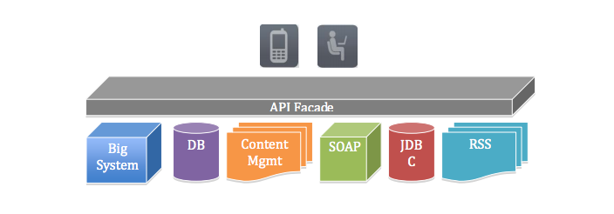
Façade
Implementing an API façade pattern involves three basic steps.
1 - Design the ideal API – design the URLs, request parameters and responses, payloads, headers, query parameters, and so on. The API design should be self-consistent.
2 - Implement the design with data stubs. This allows application developers to use your API and give you feedback even before your API is connected to internal systems.
3 - Mediate or integrate between the façade and the systems.
Notes:
The developer and the app that consume the API are on top. The API façade isolates the developer and the application and the API. Making a clean design in the facade allows you to decompose one really hard problem into a few simpler problems. “Use the façade pattern when you want to provide a simple interface to a complex subsystem. Subsystems often get more complex as they evolve.” Design Patterns – Elements of Reusable Object-Oriented Software

Slide 36
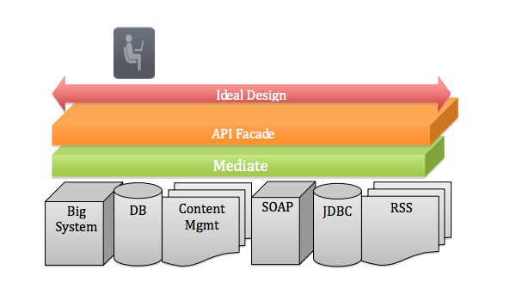
Using 3 step approach
Notes:
Using the three-step approach you’ve decomposed one big problem to three smaller problems. If you try to solve the one big problem, you’ll be starting in code, and trying to build up from your business logic (systems of record) to a clean API interface. You would be exposing objects or tables or RSS feeds from each silo, mapping each to XML in the right format before exposing to the app. It is a machine–to-machine orientation focused around an app and is difficult to get this right.
Because of where it is in the architecture, the façade becomes an interesting gateway. You can now have the façade implement the handling of common patterns (for pagination, queries, ordering, sorting, etc.), authentication, authorization, versioning, and so on, uniformly across the API.

Slide 37
Other Benefits
API Team more easily adopt different use cases
Keep pace with changing needs of developers
Protocol/Languages
Easier to extend from façade

Slide 38


